Slide 1

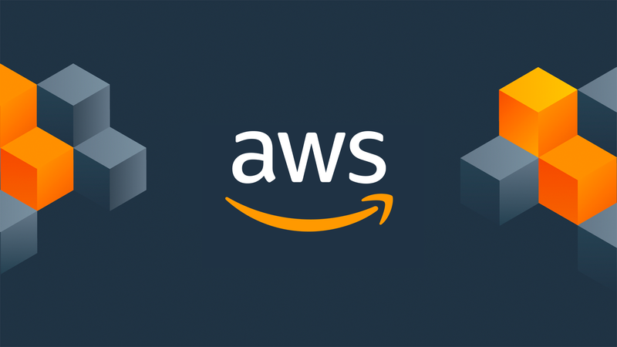


Machine Learning using AWS Amazon SageMaker Canvas
Machine Learning without Code !!!
Prince Patni

Slide 2

Are you ready to learn ML without writing Complex Codes for Months ?? Are you ready to predict your Sales outcomes quickly without having to hire Data Scientists ? Are you ready to enter the ML Domain without having enough knowledge on Statistics, Algorithms etc ? JOIN OUR COURSE TODAY !!
AWS Sagemaker Canvas Tutorial

Slide 3
> Generate ML predictions without writing code > Quickly access and prepare data for ML > Use built-in AutoML to generate predictions > Validate ML models with data scientists
Why SageMaker Canvas?
AWS Sagemaker Canvas Tutorial

Slide 4
> Predict customer churn Use product consumption and purchase history data to uncover customer churn patterns and predict those at risk of churning in the future. > Improve on-time deliveries Predict delivery times using order, fulfillment, transit, and holiday data to optimize the supply chain and deliver goods with greater efficiency. > Optimize price and revenue Predict prices of goods and services using historical demand and pricing and seasonal trends to offer the best prices to customers while maximizing revenue.
SageMaker Canvas Use Case ?
AWS Sagemaker Canvas Tutorial

Slide 5
> ML Introduction > SageMaker & SageMaker Canvas Introduction > Initial Setup Project 1 : BankNote Authentication Prediction Project 2 : SMS Spam Detection Project 3 : Customer Churn Prediction Project 4 : Wine Quality Test
Agenda
AWS Sagemaker Canvas Tutorial

Slide 6
> Basic awareness of Machine Learning > No Coding background required > No Modeling Expertise needed
Pre-Requisites
AWS Sagemaker Canvas Tutorial

Slide 7
Machine Learning using AWS Amazon SageMaker Canvas
Machine Learning without Code !!!
Prince Patni

